Slide 1


Capstone Project EDA on AirBnb Booking
By : Prabhat Rajput

Slide 2
What is AirBnb? And why we analyse it?
Airbnb is a San Francisco based American company which is founded in 2008, it is a marketplace that connects the people who want to rent out their homes with the people who are looking for accommodations in specific locales.
We analyse it because analyzing Airbnb data can help us make more informed decisions as travelers. By understanding the factors that contribute to the popularity and success of listings, we can choose accommodations that best meet our needs and preferences.

Slide 3
Problem Statement :
For this project, we are analyzing Airbnb’s New York City(NYC) data for 2019. NYC is not only the most famous city in the world but also a top global destination for visitors drawn to its museums, entertainment, restaurants, and commerce.
Our main objective is to find out the key metrics that influence the listing of properties on the platform. For this, we will explore and visualize the dataset from Airbnb in NYC using basic exploratory data analysis (EDA) techniques.
Data analysis on thousands of listings provided through Airbnb is a crucial factor for the company.
We will be finding out the distribution of every Airbnb listing based on their location, including their price range, room type, listing name, and other related factors.

Slide 4
Data Specification:
There are total 48895 rows and 16 columns.
List of Columns :-
Id - Guest Unique ID
Name - Guest Name
Host_id - Unique Host Id
Host_name - Hotel name
Neighbourhood_group - Large area
Neighbourhood - Small region or Locality
Latitude - location in degrees
Longitude - Location in degrees
Room_type - Entire home, private room etc.
Price - Charges for booking
Minimum_neights - Guest should stay or pay
Number_of_reviews - total number of reviews
Last_review - Last guest review
Reviews_per_month - total number of reviews in a month
Calculated_host_listing_count - How many time guest list it. It shows the expertise and experience.
Availability_365 - Which host is available for year

Slide 5
Agenda:
Are private rooms preferred over other room types?
Which neighborhood is preferred over all the neighborhood?
Who is the busiest host in the industry?
What is the most preferred price segment?
How many hotel available 365 days? And top 10 hotels name on the basis of highest availability for the whole year?
Distribution of listing across the neighborhood?
Grouping neighborhoods according to their location with pricing?
Correlation between all numerical features.

Slide 6
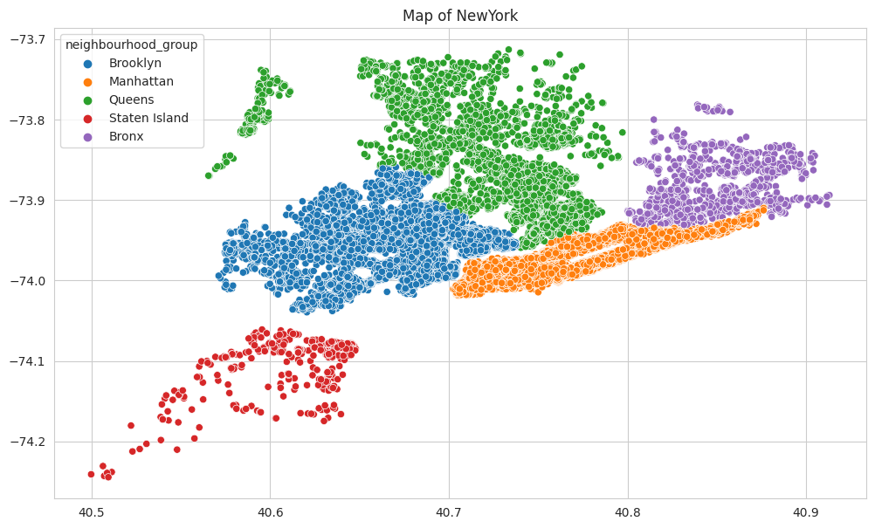
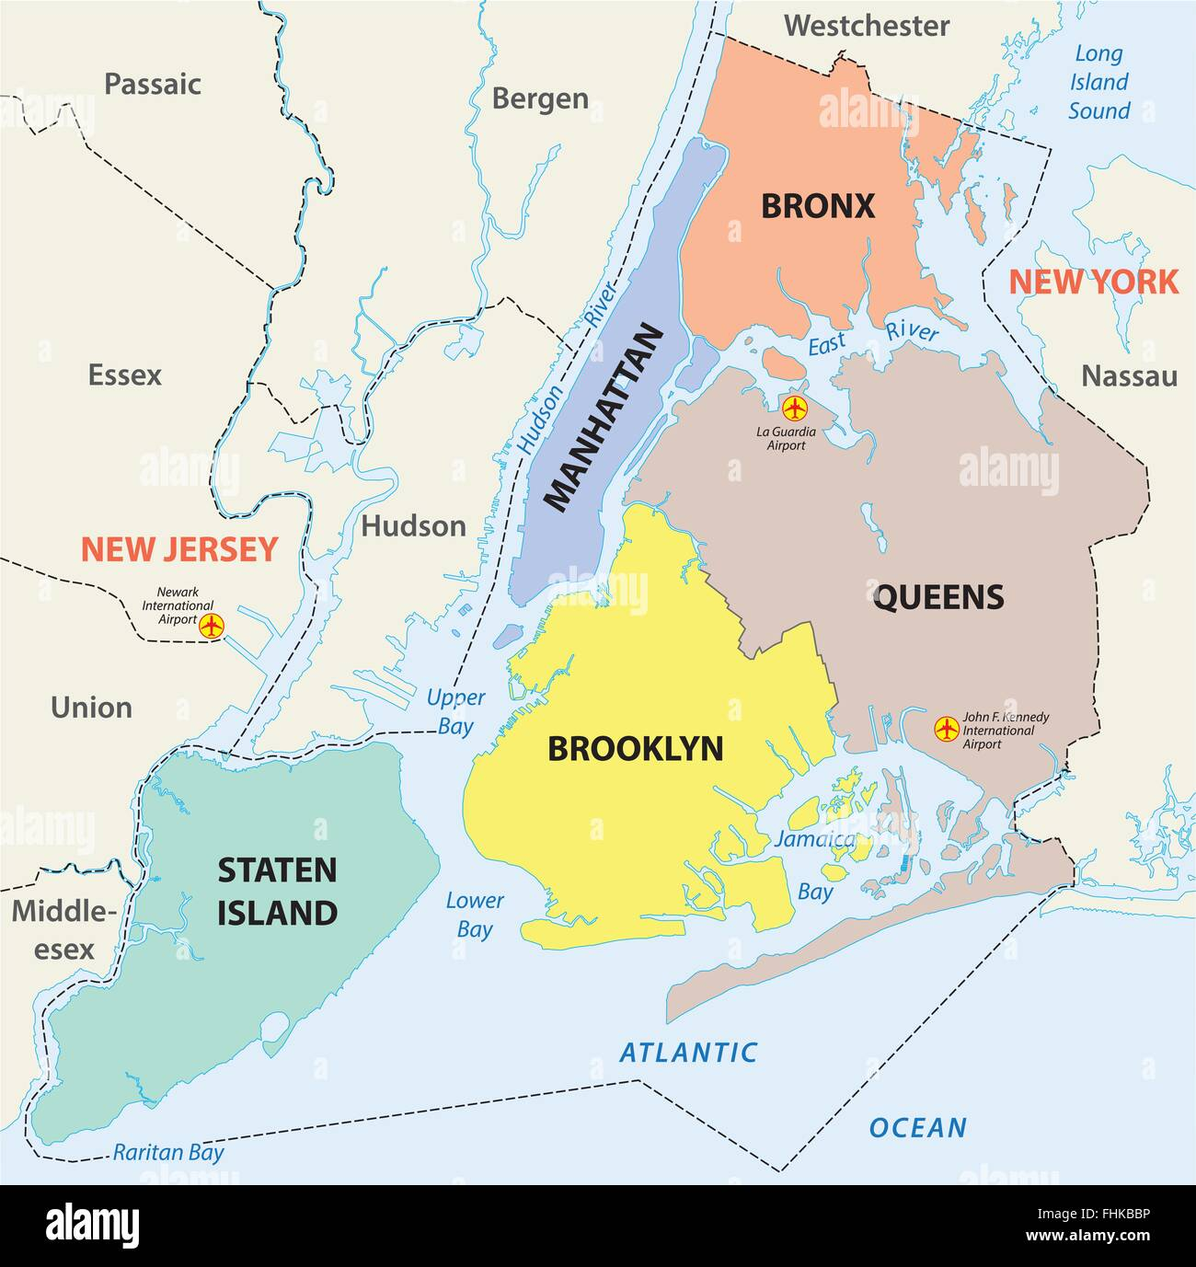
Map of New York City:

Slide 7
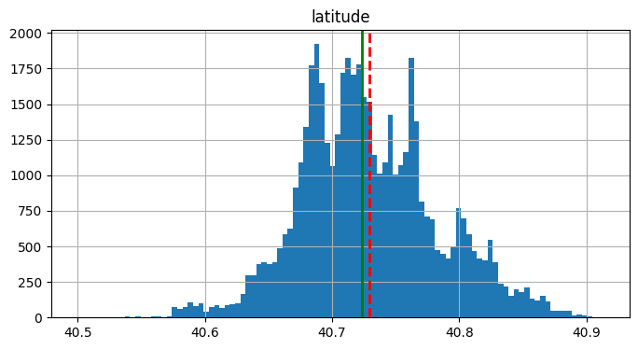
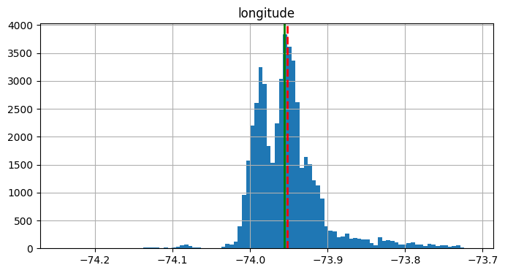
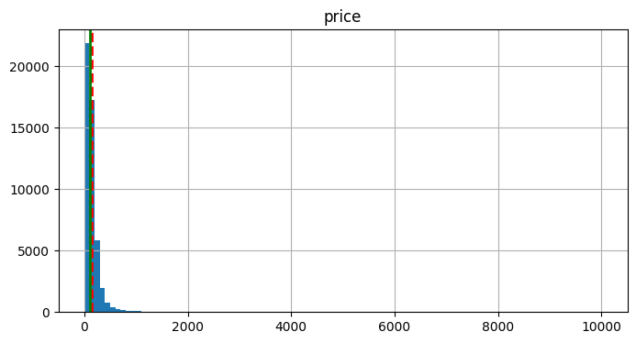
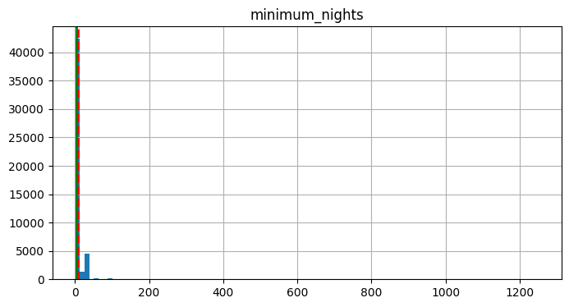
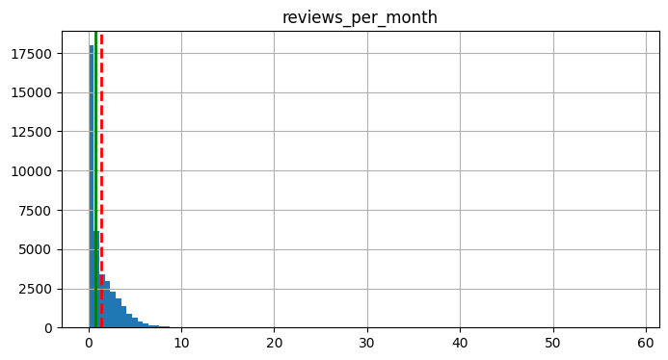
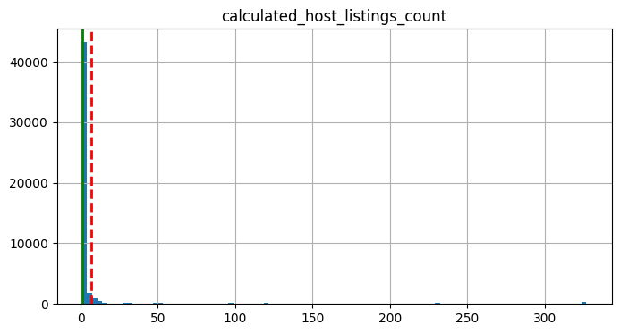
Mean and Median of all the numerical value

Slide 8
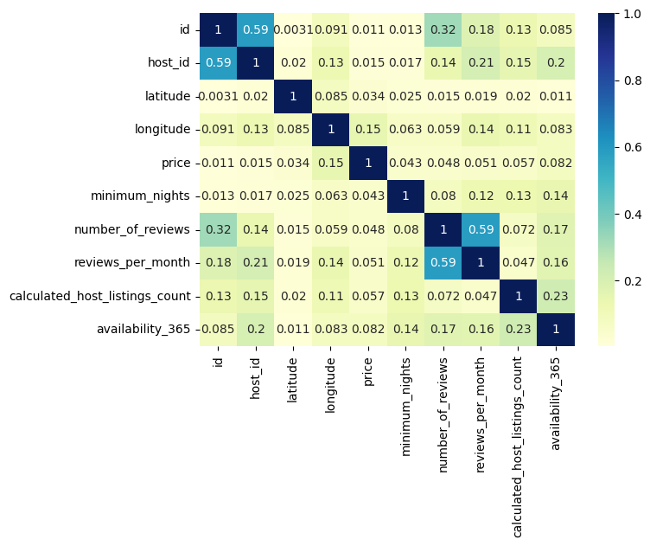
Correlation between all numerical values
As we can see from this chart that there is not that much correlation between the given category because the maximum value here we found is 0.32 between Host_id and number_of_reviews and some more correlation between host_listing_count to availability_365.

Slide 9
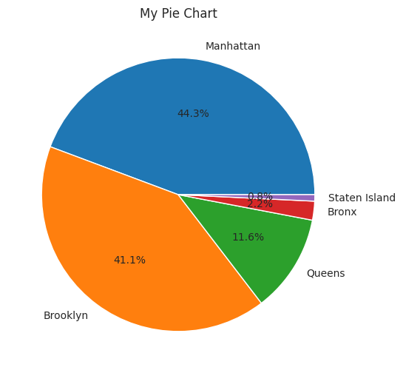
Neighborhood percentage in New York hotel Industry
We can clearly see that Manhattan and Brooklyn have above 85% market share where as State island and Bronx has least market share with approximate 3% market share.
Queens is in the middle with approximate 12% market share.

Slide 10
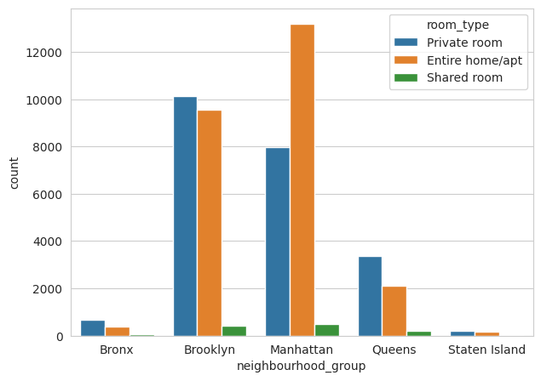
Room type in each neighborhood group:-
Listing of entire home or apartment is the highest in Manhattan while Brooklyn has private room listing at the highest though entire home or apt listing is not so far behind.
Shared room are less number in each neighborhood group.

Slide 11
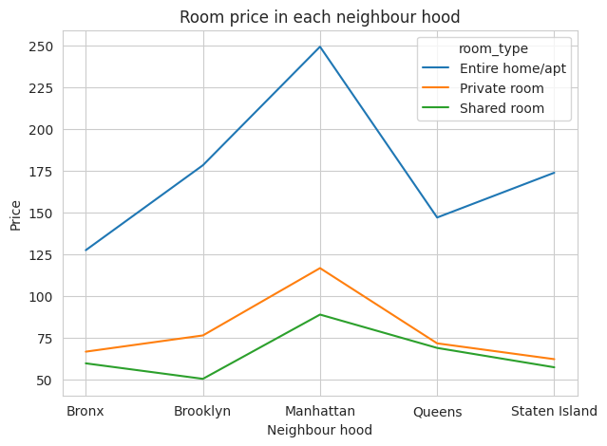
Average room prices in each neighborhood group
Looking this graph we can say that entire apartment and home are the most expensive room type and shared room are the cheapest one in all neighborhood group and the other side private room are at the middle in the price range.

Slide 12
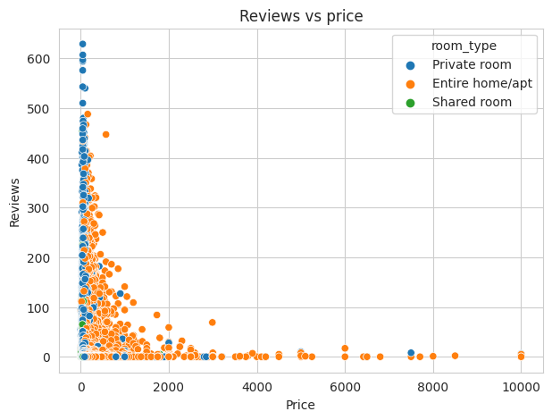
Price of host according to their number of reviews
So generally we can say that Reviews are high at low price segment and Review are low at the high price segment.
Mostly all private rooms are available under 2000 but entire home and apartment segment is gone upto 10000.

Slide 13
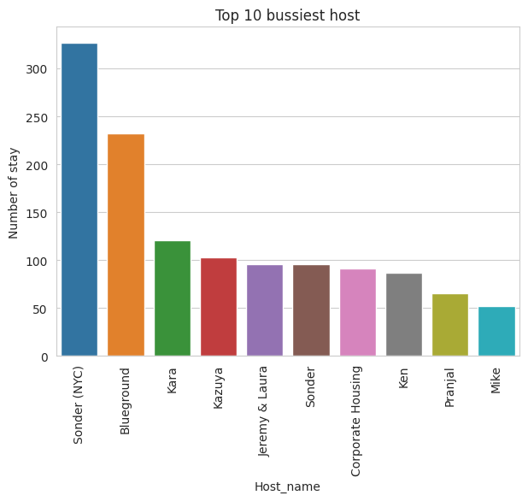
Top 10 busiest host at the Dataset
Here we can see the chart of the busiest host.
As we can see Sonder, Blueground, kara, Kazuya, Jeremy & Laura are the top 5 hosts.
Sonder(NYC) is the busiest host with 330 stays.

Slide 14
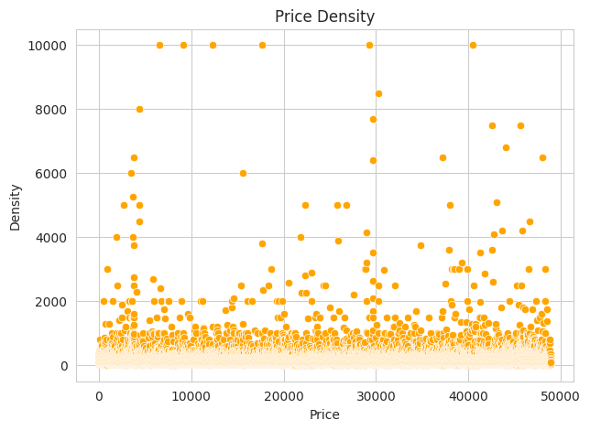
Price Density Chart :-
From the price density chart, we can find out that the density of rooms with price less than 2000 is high, which means more rooms with price less than 2000 are taken.

Slide 15
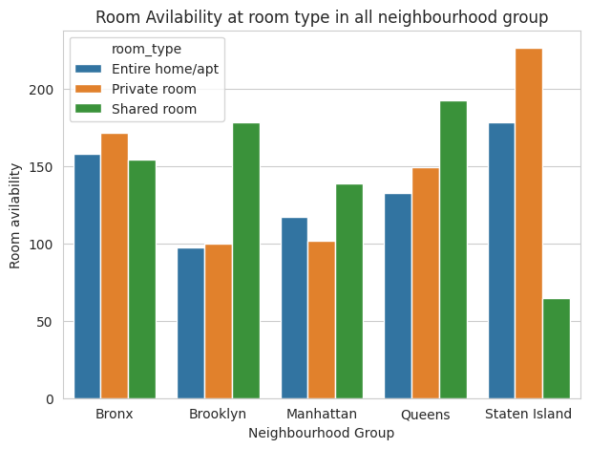
Room availability in each neighborhood group:-
According to the chart, we can say that Staten Island, Bronx and Queens has the most available private rooms, although it accounts for only 15% of the total rooms.
Means here, despite having less share in the hotel industry, the availability of rooms is more, which shows that the hotel business is the least in these neighborhood group.

Slide 16
Challenges Faced :-
Reading the dataset and understand the meaning of some columns.
For answering some of the question we had to understand the business model of Airbnb.
Handling the null values.
Design multiple visualization to summarize the information into the dataset and successfully communicate the result and trends to the reader.

Slide 17
Points which help Airbnb into their business :-
Manhattan is the most focused place in NYC for host do their business.
Customer pay highest amount in Brooklyn, Queens and Manhattan (i.e. $10000 -$10).
For the three types of room(Entire home/apt, private room and shared room) avg price is highest for Entire home/apt is 211.79, Private room is 89.78 and sharing room is 70.12.
Then we see how best rating hotels according to their price this will help in business in improvement point of view that how we can improve so our rating, reviews, listing count will increase.

Slide 18
Some more points:
And we see mostly people review those host who have less price so those host who don’t get enough reviews because may their price is too high make them less.
Upper East Side part having maximum number of list count
People choose Entire home/apt generally like so we have 52% of it, Private room 45.7% and Shared room 2.4 % so we have give more focus on Entire home/apt option so our profit will increase.
Cheap hotels attracts the customers.
Staten Island has the least hotel business.

Slide 19


